Slide 1
Stacy K Davis
Individual Project:
Autobiographical Application of Developmental Concepts
Creative Portion

Slide 2
A life story through art

Slide 3
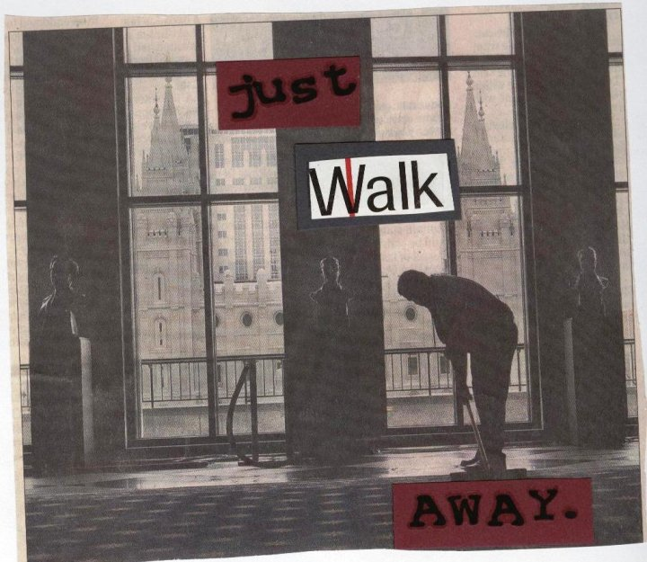
Leaving The Church

Slide 4
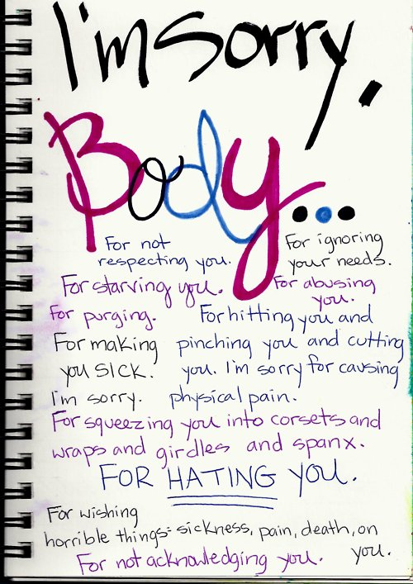
Eating Disorder Recovery

Slide 5
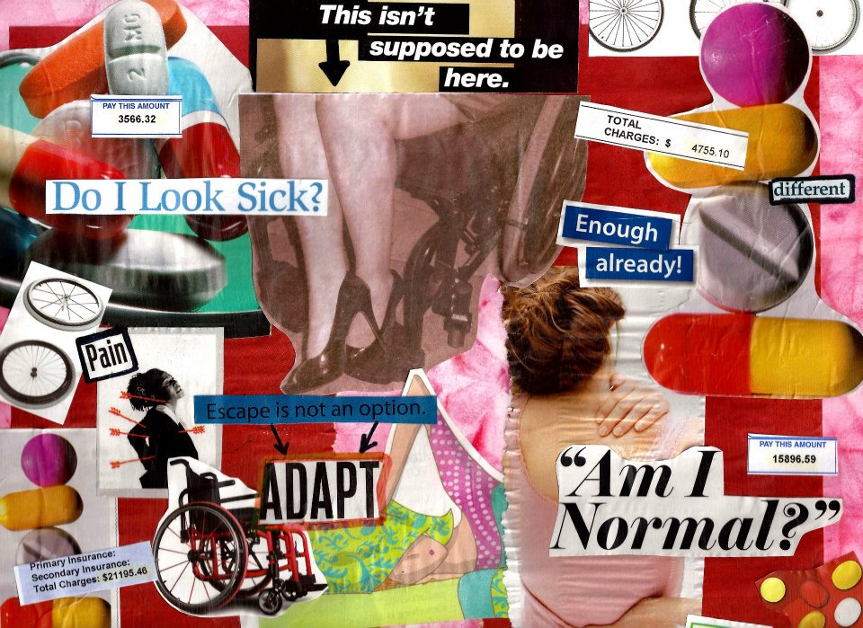
Disability and Failing Health

Slide 6
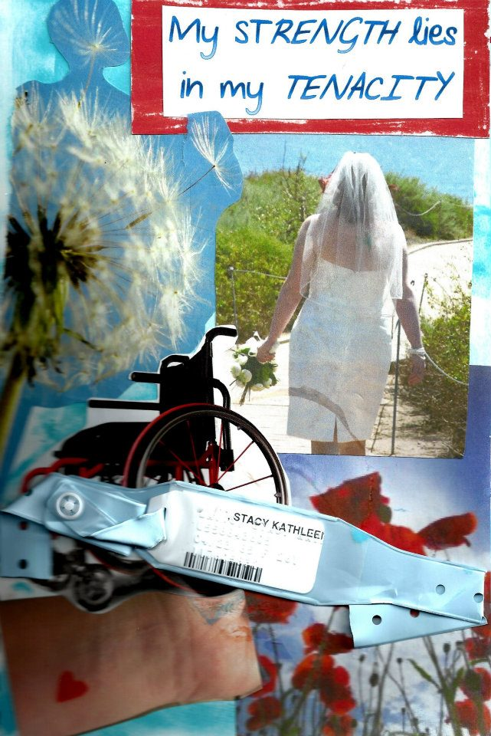
Discovering My Strength

Slide 7
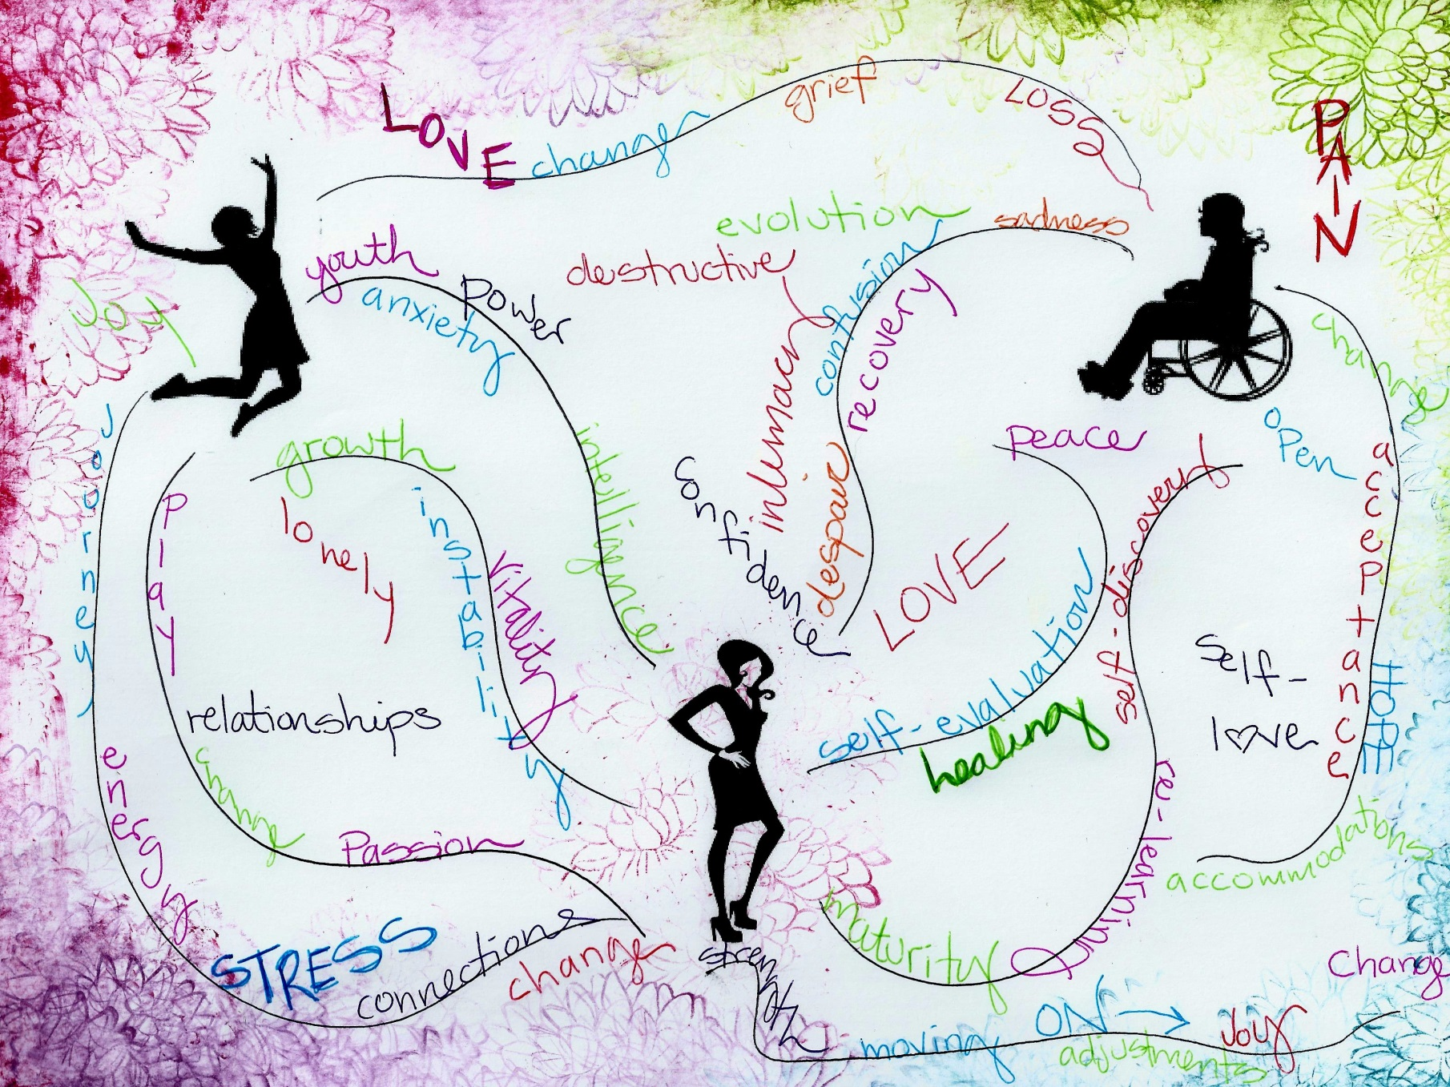
The Journey… Then and Now

Slide 8
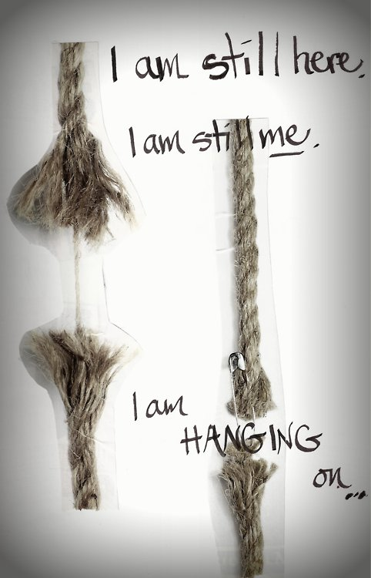
Acceptance and Moving Forward

